Slide 1
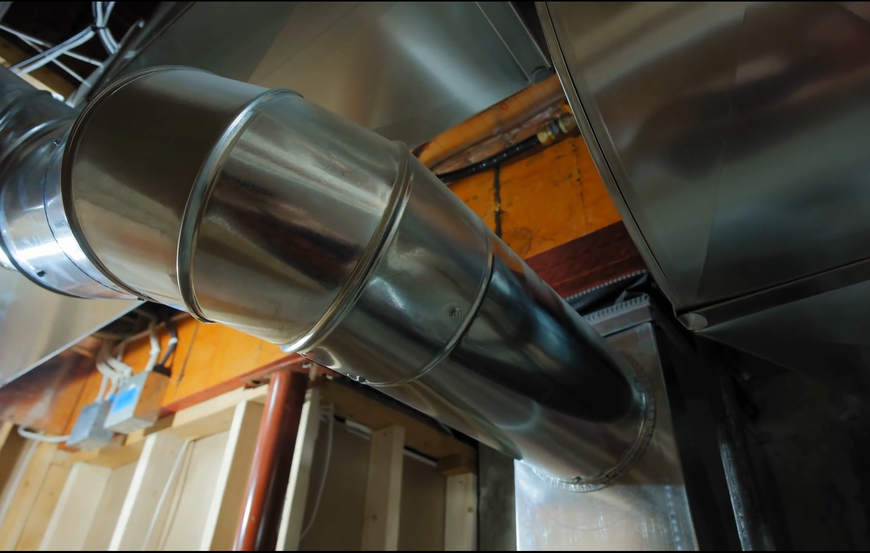
Ducts, Mufflers, and Silencers
Transfer matrix method
Tyler Dare

Slide 2
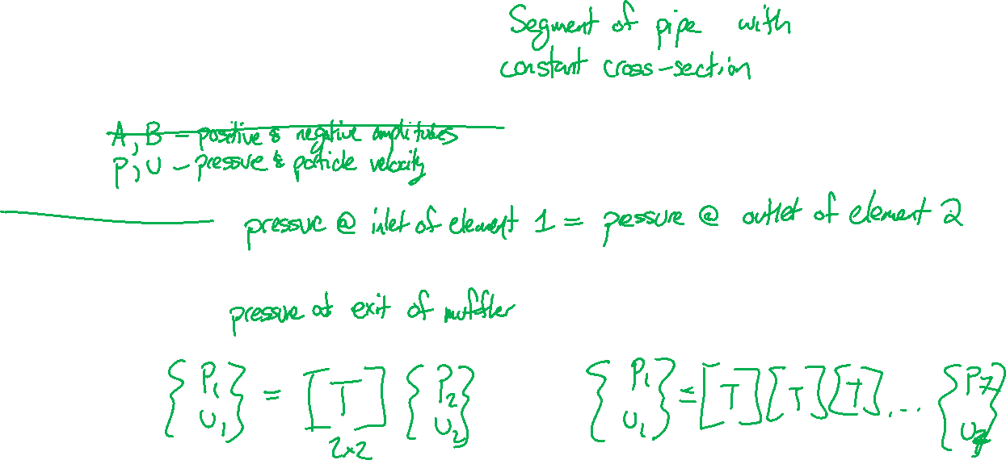
Lumped element method
Break the system up into “elements”
Calculate a small set of variables for each element
Match up variables for adjacent elements
Solve for quantities of interest

Slide 3
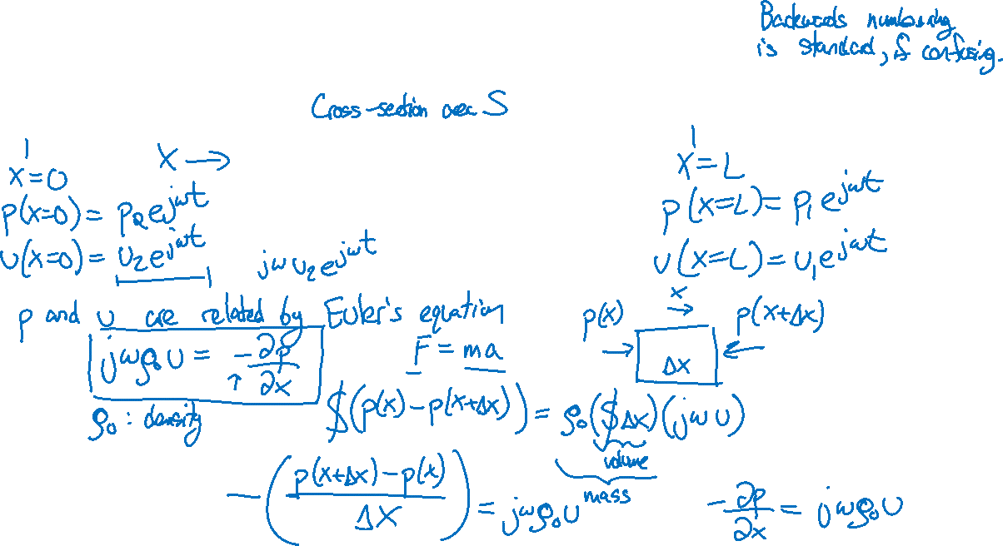
Transfer matrix for duct element

Slide 4
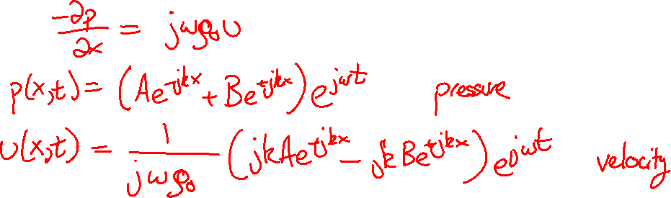

Slide 5
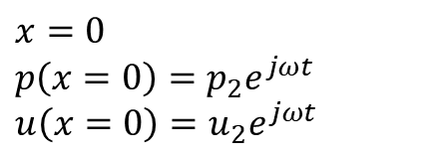
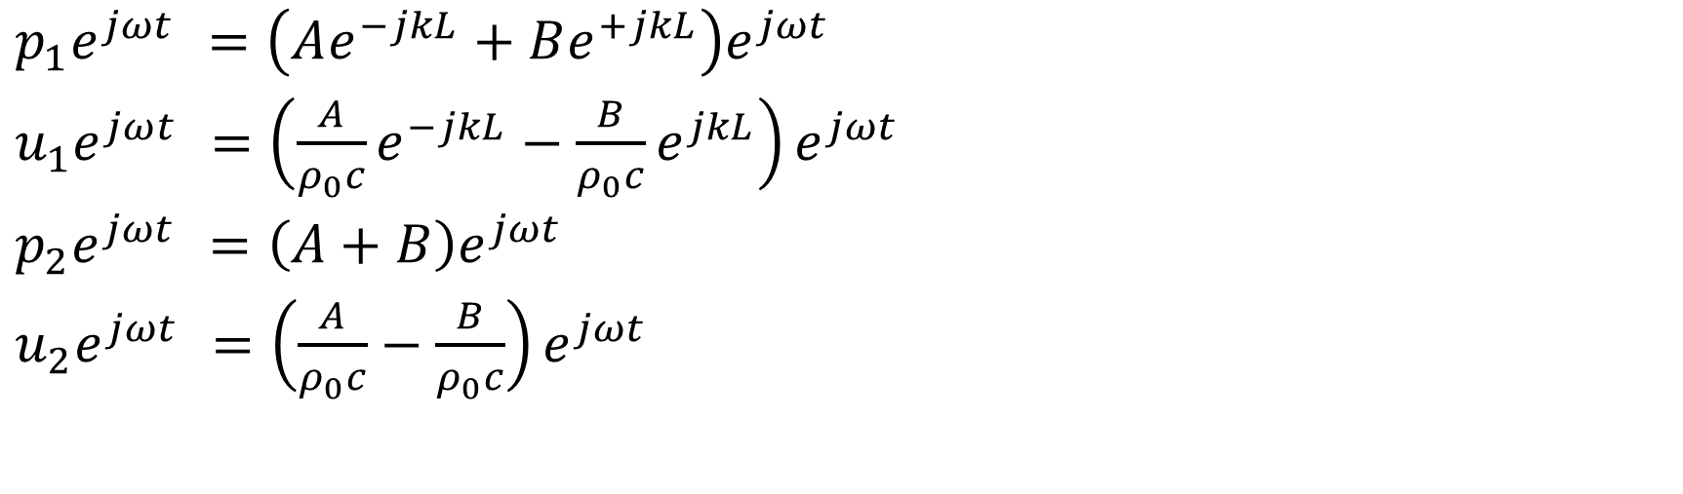
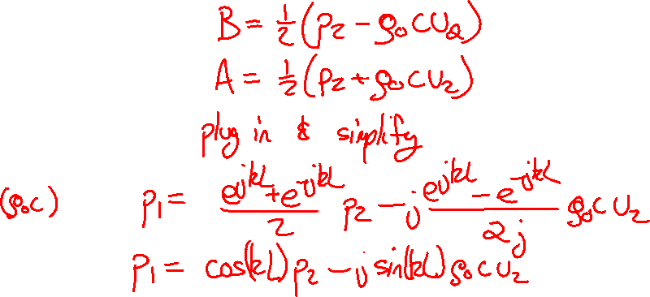
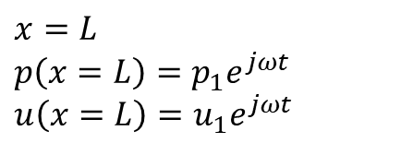
Transfer matrix for duct element
$x=0$
$p\left(x=0\right)=p_{2}e^{jωt}$
$u\left(x=0\right)=u_{2}e^{jωt}$
$x=L$
$p\left(x=L\right)=p_{1}e^{jωt}$
$u\left(x=L\right)=u_{1}e^{jωt}$
$p_{1}e^{jωt} =\left(Ae^{−jkL}+Be^{+jkL}\right)e^{jωt}$
$u_{1}e^{jωt} =\left(\frac{A}{ρ_{0}c}e^{−jkL}−\frac{B}{ρ_{0}c}e^{jkL}\right)e^{jωt}$
$p_{2}e^{jωt} =\left(A+B\right)e^{jωt}$
$u_{2}e^{jωt} =\left(\frac{A}{ρ_{0}c}−\frac{B}{ρ_{0}c}\right)e^{jωt}$

Slide 6
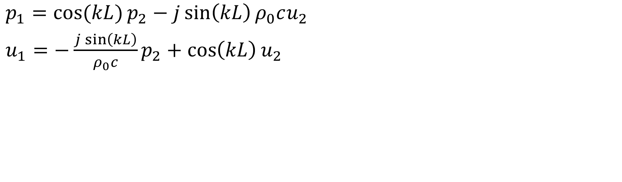
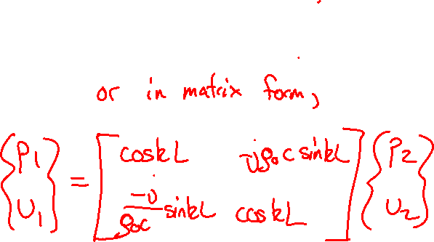
Transfer matrix for duct element
$x=0$
$p\left(x=0\right)=p_{2}e^{jωt}$
$u\left(x=0\right)=u_{2}e^{jωt}$
$x=L$
$p\left(x=L\right)=p_{1}e^{jωt}$
$u\left(x=L\right)=u_{1}e^{jωt}$
$p_{1}=\cos{(kL)}p_{2}−j\sin\left(kL\right)ρ_{0}cu_{2}$
$u_{1}=−\frac{j\sin\left(kL\right)}{ρ_{0}c}p_{2}+\cos\left(kL\right)u_{2}$

Slide 7
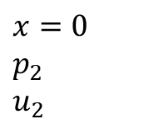
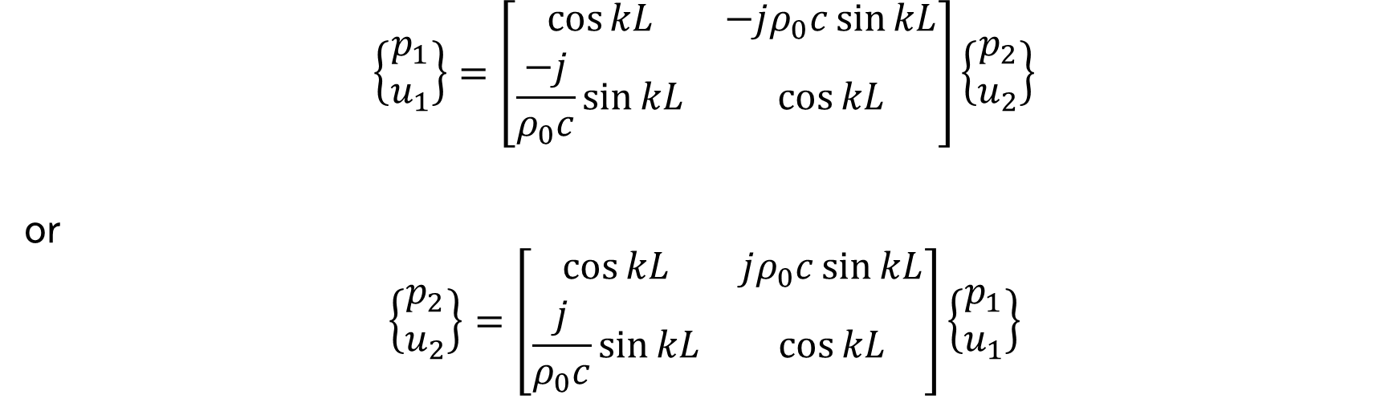
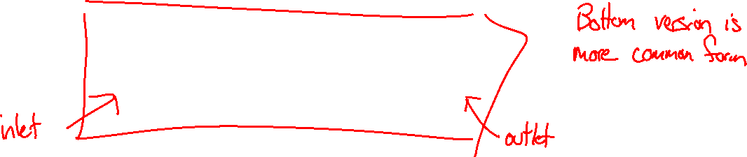
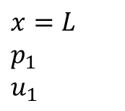
Transfer matrix for duct element
$x=0$
$p_{2}$
$u_{2}$
$x=L$
$p_{1}$
$u_{1}$
$$\left\{\begin{aligned}p_{1} \\ u_{1}\end{aligned}\right\}=\left[\begin{matrix}\cos{kL} & −jρ_{0}c\sin{kL} \\ \frac{−j}{ρ_{0}c}\sin{kL} & \cos{kL}\end{matrix}\right]\left\{\begin{aligned}p_{2} \\ u_{2}\end{aligned}\right\}$$
or
$$\left\{\begin{aligned}p_{2} \\ u_{2}\end{aligned}\right\}=\left[\begin{matrix}\cos{kL} & jρ_{0}c\sin{kL} \\ \frac{j}{ρ_{0}c}\sin{kL} & \cos{kL}\end{matrix}\right]\left\{\begin{aligned}p_{1} \\ u_{1}\end{aligned}\right\}$$

Slide 8
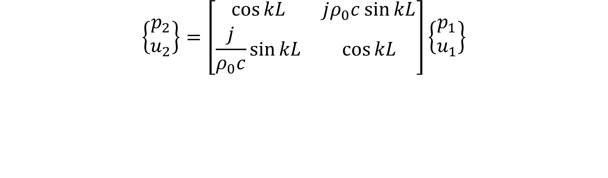
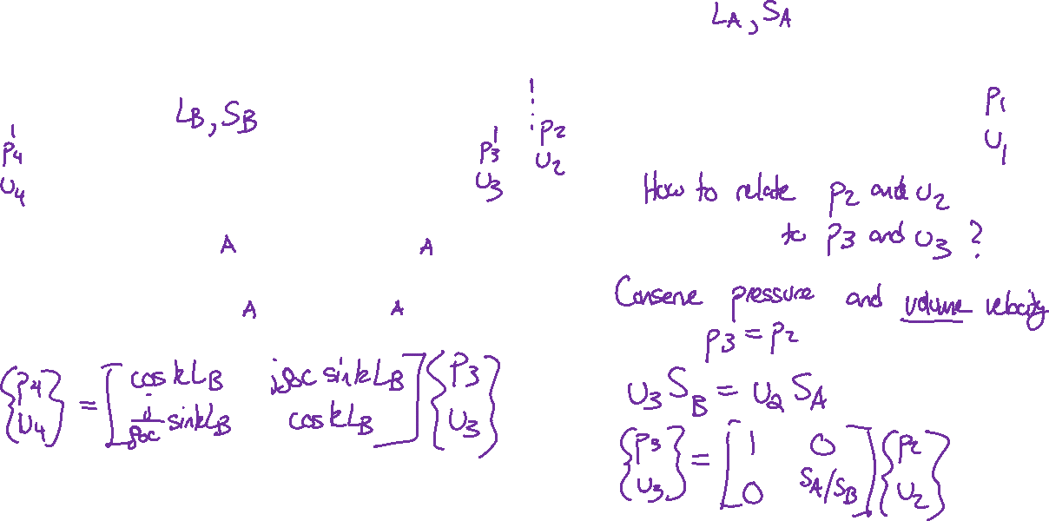
Connecting duct segments
$$\left\{\begin{aligned}p_{2} \\ u_{2}\end{aligned}\right\}=\left[\begin{matrix}\cos{kL} & jρ_{0}c\sin{kL} \\ \frac{j}{ρ_{0}c}\sin{kL} & \cos{kL}\end{matrix}\right]\left\{\begin{aligned}p_{1} \\ u_{1}\end{aligned}\right\}$$

Slide 9



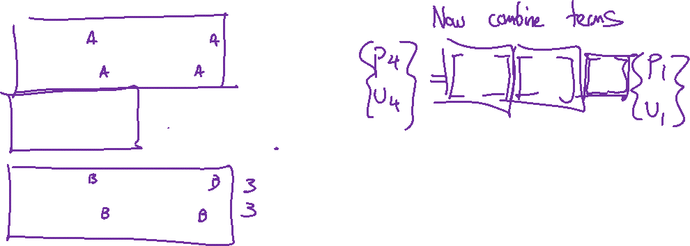
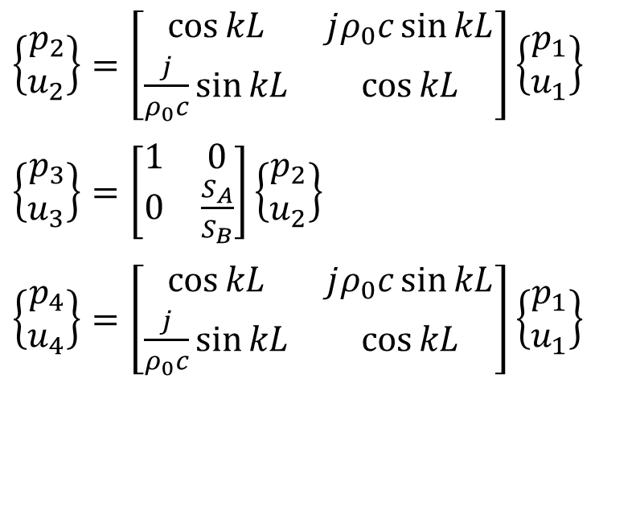





Connecting duct segments
$$S_{A}$$
$$S_{B}$$
$p_{2}$
$u_{2}$
$$L_{A}$$
$p_{1}$
$u_{1}$
$p_{4}$
$u_{4}$
$$L_{B}$$
$p_{3}$
$u_{3}$
$\left\{\begin{aligned}p_{2} \\ u_{2}\end{aligned}\right\}=\left[\begin{matrix}\cos{kL} & jρ_{0}c\sin{kL} \\ \frac{j}{ρ_{0}c}\sin{kL} & \cos{kL}\end{matrix}\right]\left\{\begin{aligned}p_{1} \\ u_{1}\end{aligned}\right\}$
$\left\{\begin{aligned}p_{3} \\ u_{3}\end{aligned}\right\}=\left[\begin{matrix}1 & 0 \\ 0 & \frac{S_{A}}{S_{B}}\end{matrix}\right]\left\{\begin{aligned}p_{2} \\ u_{2}\end{aligned}\right\}$
$\left\{\begin{aligned}p_{4} \\ u_{4}\end{aligned}\right\}=\left[\begin{matrix}\cos{kL} & jρ_{0}c\sin{kL} \\ \frac{j}{ρ_{0}c}\sin{kL} & \cos{kL}\end{matrix}\right]\left\{\begin{aligned}p_{1} \\ u_{1}\end{aligned}\right\}$

Slide 10






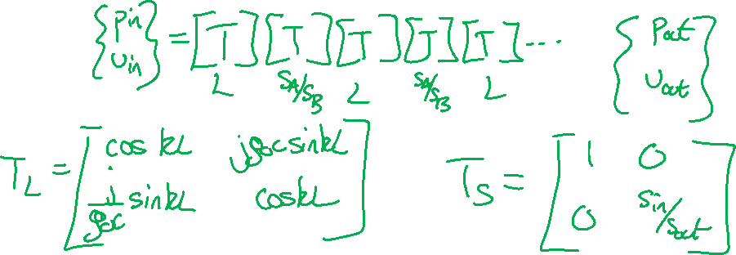
Connecting duct segments
$$A_{3},L_{3}$$
$$A_{1},L_{1}$$
$$A_{4},L_{4}$$
$$A_{2},L_{2}$$
$p_{out}$
$u_{out}$
$p_{in}$
$u_{in}$

Slide 11
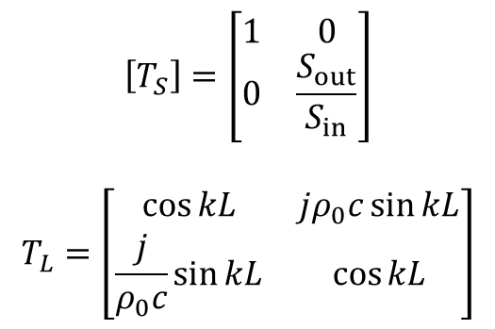
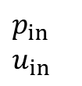
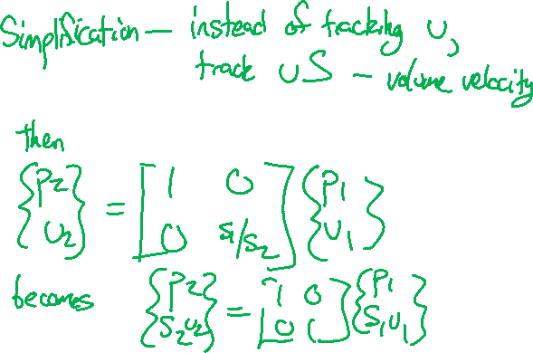
Connecting duct segments
$$A_{3},L_{3}$$
$$A_{1},L_{1}$$
$$A_{4},L_{4}$$
$$A_{2},L_{2}$$
$p_{out}$
$u_{out}$
$p_{in}$
$u_{in}$
$$\left[T_{S}\right]=\left[\begin{matrix}1 & 0 \\ 0 & \frac{S_{out}}{S_{in}}\end{matrix}\right]$$
$$T_{L}=\left[\begin{matrix}\cos{kL} & jρ_{0}c\sin{kL} \\ \frac{j}{ρ_{0}c}\sin{kL} & \cos{kL}\end{matrix}\right]$$

Slide 12



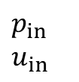

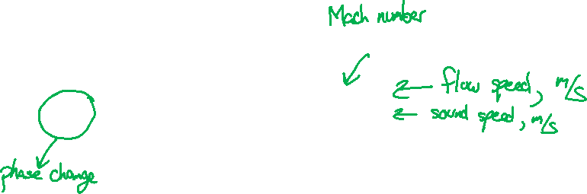
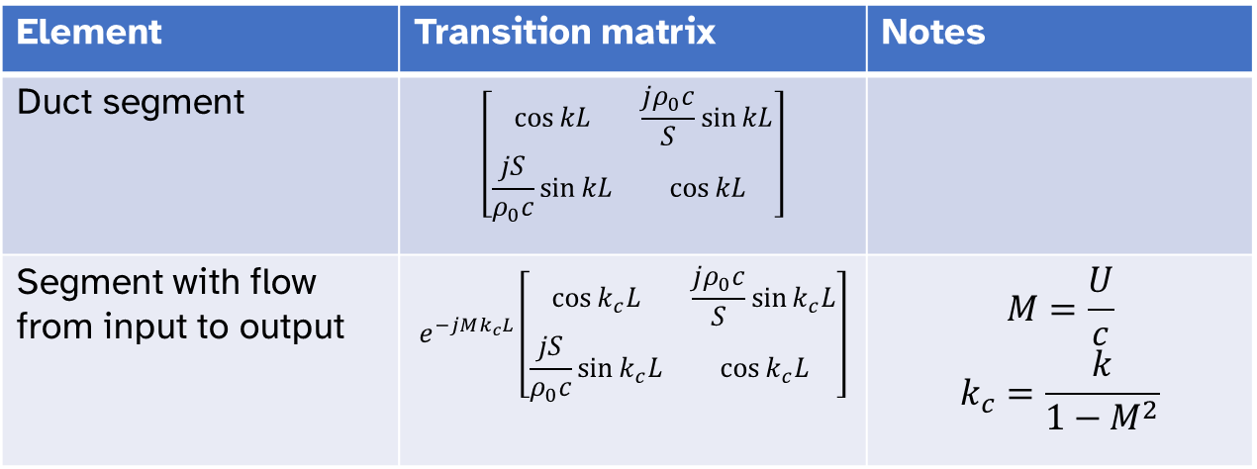

Four-pole matrices
$$\left[T_{4}\right]$$
$$\left[T_{3}\right]$$
$$\left[T_{1}\right]$$
$p_{out}$
$u_{out}$
$$\left[T_{2}\right]$$
$p_{in}$
$u_{in}$
$\left\{\begin{aligned}p_{in} \\ {S_{in}u}_{in}\end{aligned}\right\}=\left[T_{N}\right]…\left[T_{2}\right]\left[T_{1}\right]\left\{\begin{aligned}p_{out} \\ {S_{out}u}_{out}\end{aligned}\right\}$ Matrices numbered outlet to inlet
Element | Transition matrix | Notes
Duct segment | $$\left[\begin{matrix}\cos{kL} & \frac{jρ_{0}c}{S}\sin{kL} \\ \frac{jS}{ρ_{0}c}\sin{kL} & \cos{kL}\end{matrix}\right]$$
Segment with flow from input to output | $$e^{−jMk_{c}L}\left[\begin{matrix}\cos{k_{c}L} & \frac{jρ_{0}c}{S}\sin{k_{c}L} \\ \frac{jS}{ρ_{0}c}\sin{k_{c}L} & \cos{k_{c}L}\end{matrix}\right]$$ | $$M=\frac{U}{c}$$ $$k_{c}=\frac{k}{1−M^{2}}$$

Slide 13
How “good” is a noise treatment?
“Noise Reduction”: how much quieter is it on the receiver side compared to the source side?
“Insertion loss”: how much quieter did the receiver get when I added the treatment?
“Transmission loss”: how much power is transmitted compared to incident?

Slide 14

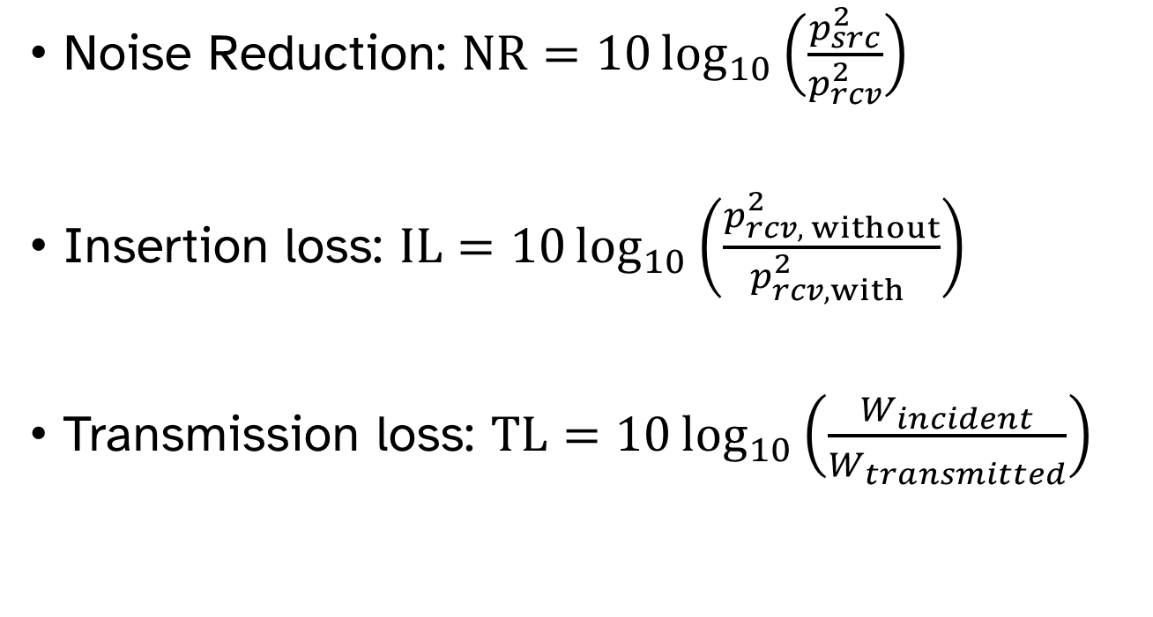



How “good” is a noise treatment?
Noise Reduction: $NR=10\log_{10}\left(\frac{p_{src}^{2}}{p_{rcv}^{2}}\right)$
Insertion loss: $IL=10\log_{10}\left(\frac{p_{rcv, without}^{2}}{p_{rcv, with}^{2} }\right)$
Transmission loss: $TL=10\log_{10}\left(\frac{W_{incident}}{W_{transmitted}}\right)$
$$W_{incident}→$$
$$W_{transmitted}→$$
Treatment
$$p_{src}$$
$$p_{rcv}$$

Slide 15

Impedance formulation
How do we calculate performance metrics from the transfer matrix?
$$\left\{\begin{aligned}p_{2} \\ {S_{2}u}_{2}\end{aligned}\right\}=\left[\begin{matrix}T_{11} & T_{12} \\ T_{21} & T_{22}\end{matrix}\right]\left\{\begin{aligned}p_{1} \\ S_{1}u_{1}\end{aligned}\right\}$$

Slide 16
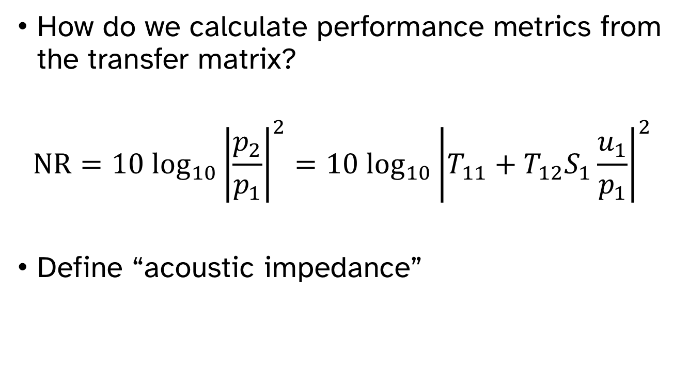
Impedance formulation
How do we calculate performance metrics from the transfer matrix?
$$NR=10 \log_{10}{\left|\frac{p_{2}}{p_{1}}\right|}^{2}={10 \log_{10}\left|T_{11}+T_{12}S_{1}\frac{u_{1}}{p_{1}}\right|}^{2}$$
Define “acoustic impedance”

Slide 17
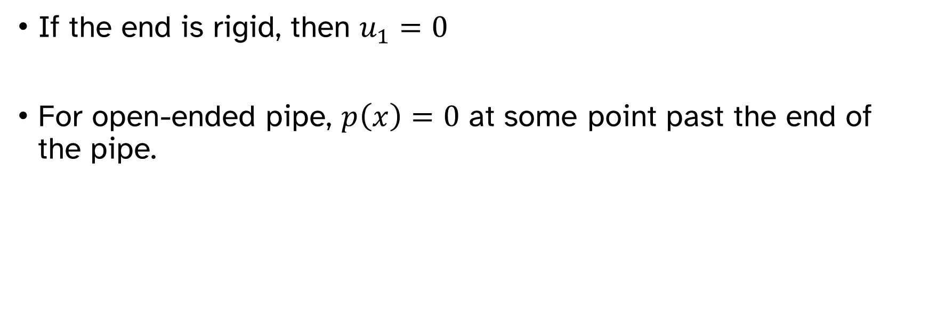


End conditions
$p_{1}$
$u_{1}$
$$Z_{1}=\frac{p_{1}}{u_{1}S_{1}}$$
If the end is rigid, then $u_{1}=0$
For open-ended pipe, $p\left(x\right)=0$ at some point past the end of the pipe.

Slide 18








End conditions
$p_{1}$
$u_{1}$
$$Z_{1}=j\frac{ρ_{0}c}{S_{1}}\tan\left(k(L+l_{o})\right)$$
Opening diameter = pipe diameter
Opening diameter < pipe diameter
Flanged
$$a$$
$$l_{o}=\frac{8a}{3π}$$
$$l_{o}=\frac{8a}{3π}(1−1.25ξ)$$
$$l_{o}$$
$$l_{o}$$
$$ξ=aspect ratio=\frac{Orifice diameter}{Tube diameter}$$
Unflanged
$$l_{o}=0.61a$$
$$l_{o}$$

Slide 19


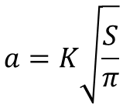
What if the orifice of the pipe/duct isn’t round?
Assume the ratio of orthogonal dimensions is not much different from 1
High aspect ratios
$$a=K\sqrt{\frac{S}{π}}$$
$$P_{D}=Perimeter$$
Convert
$$a≈\frac{2S}{P_{D}}$$
Reproduced from Bies, Hansen & Howard - Figure 8.5

